Slide 1

Annual Report 2022 - Sales Analysis Report
PRESENTED BY
VAISHNAVI BHUJBAL.

Slide 2
agenDA OF Report
INTRODUCTION
OBJECTIVE
ANALYSIS OF VISUAL
KAY BUSINESS QUESTIONS ANSWERED
SIGNIFICANCE OF VISUALS
INSIGHTS
CONCLUSION

Slide 3
Introduction
The dashboard provides a comprehensive overview of the sales performance of Vrinda Store for the year 2022.
It analyzes key metrics like monthly sales, top-performing states, best-selling categories, sales channel contributions, order statuses, customer demographics, and more.
This report aims to interpret each visual, explain its utility, and address the business questions it solves.

Slide 4
Objective
Identifying monthly sales trends and peak periods.
Evaluating top-performing states and regions.
Understanding customer demographics (gender and age).
Assessing the performance of sales channels and product categories.
Monitoring order efficiency (deliveries, cancellations, returns).
Supporting data-driven decision-making for future growth.

Slide 5
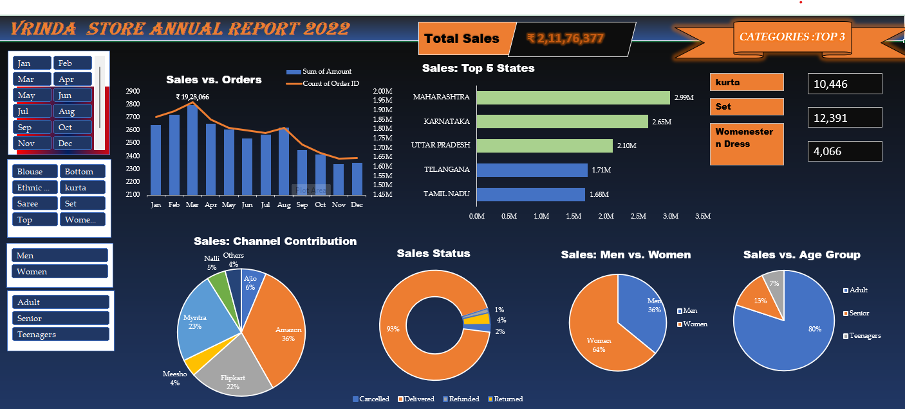
COMPLETE DASHBOARD
VRINDA STORE ANNUAL REPORT 2022

Slide 6
Analysis of visual KEy business Questions answered Significance of visual
NEXT SLIDES WITH VISUALS SHOWS THE ABOVE POINTS :

Slide 7

1. Total Sales (Highlight)
What it Shows: Total revenue: ₹2,11,76,377.
Purpose: Quick KPI overview.
Business Questions: How much was earned in 2022?
Why this Chart: Simple number format for instant focus

Slide 8
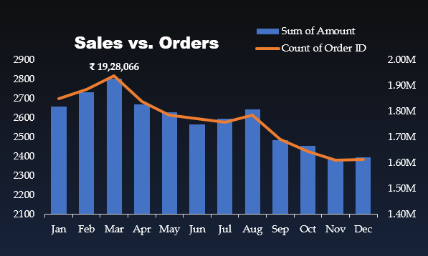
2. Sales vs. Orders (Bar + Line Chart)
What it Shows: Monthly sales (bars) and order trends (line).
Purpose: Tracks seasonality and revenue-order relationships.
Business Questions: When are peak sales, and are they driven by higher orders or order value?
Why this Chart: Bar charts show monthly totals; line charts highlight trends.

Slide 9
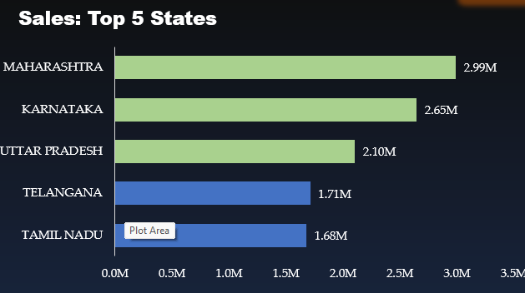
3. Top 5 States (Horizontal Bar Chart)
What it Shows: Revenue contribution from the top states.
Purpose: Identifies high-performing regions.
Business Questions: Which states lead sales, and where is growth needed?
Why this Chart: Horizontal bars make ranking and comparisons clear.

Slide 10
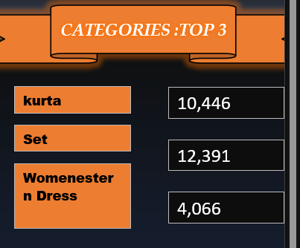
4. Categories: Top 3 (Text)
What it Shows: Top-selling categories: Kurta, Set, Women’s Western Dress.
Purpose: Highlights popular products for stock and promotion focus.
Business Questions: Which products drive sales?
Why this Format: Text avoids clutter while delivering key insights.

Slide 11
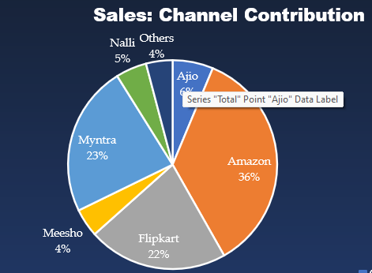
5. Channel Contribution (Pie Chart)
What it Shows: Sales share by e-commerce platforms.
Purpose: Understand channel performance.
Business Questions: Which platforms dominate, and which need attention?
Why this Chart: Pie charts visually show proportional contributions.

Slide 12
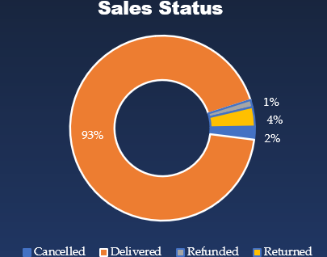
6. Sales Status(Doughnut Chart)
What it Shows: Order statuses: Delivered (93%), Cancelled (4%), etc.
Purpose: Tracks order completion and issues.
Business Questions: How efficient is delivery, and are cancellations impacting sales?
Why this Chart: Doughnut charts emphasize the largest segments while showing smaller ones

Slide 13
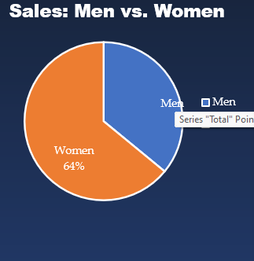
7. Men vs. Women(Pie Chart)
What it Shows: Gender-wise sales: Women (64%), Men (36%).
Purpose: Understand customer demographics.
Business Questions: Who are the primary customers?
Why this Chart: Pie charts show simple binary comparisons effectively.

Slide 14
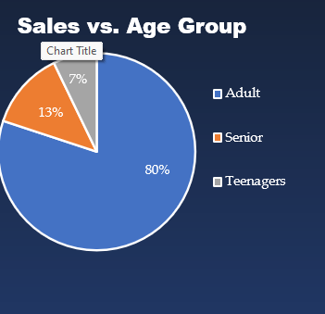
8. Sales by Age Group(Pie Chart)
What it Shows: Age-wise sales: Adults (80%), Seniors (13%), Teenagers (7%).
Purpose: Identify key customer age groups.
Business Questions: Which age groups to target?
Why this Chart: Pie charts make demographic proportions easy to interpret.

Slide 15
INSIGHTS
The analysis reveals that Vrinda Store achieved ₹2,11,76,377 in revenue in 2022, with peak sales during specific months.
Maharashtra and Karnataka are top-performing states, while categories like Kurta and Set drive sales.
Women (64%) and adults (80%) dominate the customer base, emphasizing the need for targeted marketing.
Amazon and Flipkart contribute the most sales, but smaller channels like Ajio and Meesho have growth potential.
With 93% of orders delivered, operational efficiency is strong, though cancellations and returns need improvement.

Slide 16
CONCLUSION
Overall, this project provides a foundation for data-driven decision-making, helping Vrinda Store strategically plan for future growth by optimizing regional and demographic targeting, product focus, and channel performance , optimize inventory, expand reach in new regions, and enhance customer satisfaction, positioning the business for continued growth in the coming year.

Slide 17
Thank you

